Slide 1
MODULE 4:
FUZZY SYSTEMS

Slide 2
Topics to be covered:
Crisp Logic
Predicate Logic
Fuzzy Logic
Fuzzy Rule Based Logic
Defuzzification Methods
Applications

Slide 3
Crisp Logic

Slide 4



Traditional (crisp) logic
A rose is either RED or not RED.

Slide 5
Classical Set (Crisp)
Contain objects that satisfy precise properties of membership.
  Example: Set of heights from 5 to 7 feet
1 x ≤ A
χ (x) = {
A
0 x > A
Characteristic Function
1
0
5
6
7
X (height)

Slide 6
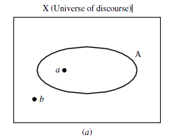
Classical Sets
the universe of discourse is the universe of all available information on a given problem
a universe of discourse, X, as a collection of objects all having the same characteristics
The individual elements in the universe X will be denoted as x.
The total number of elements in a universe X is called its cardinal number, denoted n_{x}

Slide 7
Classical Sets
Collections of elements within a universe are called sets
Collections of elements within sets are called subsets
The collection of all possible sets in the universe is called the whole set (power set).

Slide 8
Propositional logic
Logical constants: true, false
Propositional symbols: P, Q, R, S, ...
Wrapping parentheses: ( … )
Sentences are combined by connectives:
  ∧ ...and [conjunction]
  ∨ ...or [disjunction]
  ⇒...implies [implication / conditional]
  ⇔..is equivalent [biconditional]
  ¬ ...not [negation]

Slide 9
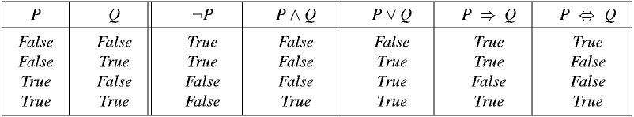
Truth table for all connectives
The five logical connectives:

Slide 10
  is (( P ⇒ Q) ∧ (Q ⇒ P) = ( P = Q) ) a tautology?

Slide 11
Laws of Propositional Logic
Commutativity A ∨ B = B ∨ A
A ∧ B = B ∧ A
Associativity A ∨ (B ∨ C) = (A ∨ B) ∨ C
A ∧ (B ∧ C) = (A ∧ B) ∧ C
Distributivity A ∨ (B ∧ C) = (A ∨ B) ∧ (A ∨ C)
A ∧ (B ∨ C) = (A ∧ B) ∨ (A ∧ C)
Idempotency A ∨ A = A
A ∧ A = A
Identity A ∨ False = A
A ∧ true = A
A ∧ False = False
A ∨ True = True

Slide 12
Laws of Propositional Logic (Contd…)
Negation A ∨ ~A = True
A ∧ ~A = False
Absorption A ∨ (A ∧ B) = A
A ∧ (A ∨ B) = A
De Morgan’s Laws ~(A ∧ B) = (~A ∨ ~B)
~(A ∨ B) = (~A ∧ ~B)
Involution ~(~A) = A

Slide 13
Inference rules
Inference is a technique by which, given set of facts or premises F1, F2,…., Fn, a goal G is to be derived.
Various forms of tautologies can be used for making deductive inferences. They are referred to as inference rules.
Examples :

Slide 14
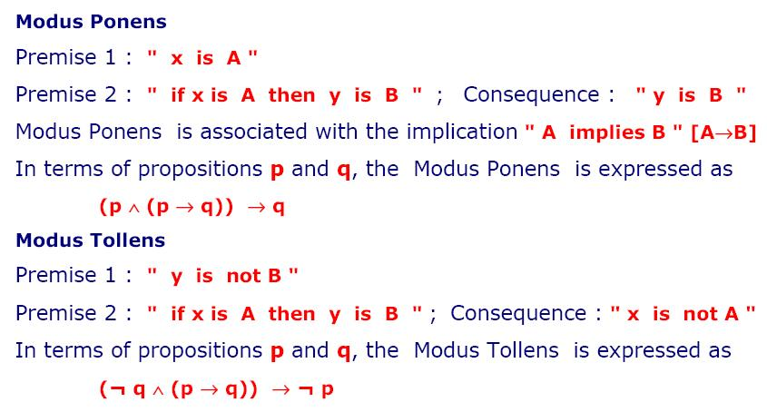

Slide 15
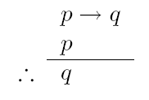
Valid Arguments using Propositional Logic
Consider the following argument (sequence of propositions):
If the prof offers chocolate for an answer, you answer the prof’s question.
The prof offers chocolate for an answer.
Therefore, you answer the prof’s question.
Let p be “the prof offers chocolate for an answer” and q be “you answer the prof’s question”.
The form of the above argument is:
The argument is valid since ((p → q) ∧ p) → q is a tautology.

Slide 16
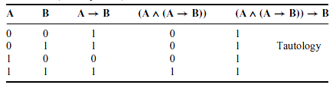
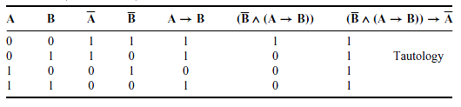
Inference in Proposition Logic
Tautologies
Truth table (modus ponens)
Truth table (modus tollens)

Slide 17
Example
  Given
  C ∨ D
  ~H ⇒ (A ∧ ~B)
  (C ∨ D) ⇒ ~H
  (A ∧ ~B) ⇒ (R ∨ S)
  Can (R ∨ S) be inferred from the above?

Slide 18
Predicate Logic

Slide 19
Predicate Logic
Alternative names:
Predicate Logic
Quantificational Logic
First Order Logic

Slide 20
Predicate Logic
Although Propositional Logic is complete…
It is still inadequate.
In propositional logic, each possible atomic fact requires a separate unique propositional symbol.
If there are n people and m locations, representing the fact that some person moved from one location to another requires nm² separate symbols.

Slide 21
Predicate Logic
Predicate logic includes a richer ontology:
  -objects (terms)
  -properties (unary predicates on terms)
  -relations (n-ary predicates on terms)
  -functions (mappings from terms to other terms)
Allows more flexible and compact representation of knowledge
Move(x, y, z) for person x moved from location y to z

Slide 22
Predicate Logic
Example:
All men are mortal.
Socrates is a man.
Socrates is mortal.
VALID

Slide 23
Predicate Logic
All men are mortal.
Socrates is a man.
Socrates is mortal.
P
Q
R
VALID

Slide 24
Predicate Logic
All men are mortal.
Socrates is a man.
Socrates is mortal.
INVALID
FORM
P
Q
R
VALID

Slide 25
Predicate Logic
All men are mortal.
Socrates is a man.
Socrates is mortal.
VALID

Slide 26
Predicate Logic
All men are mortal.
Socrates is a man.
Socrates is mortal.
All A are B
n is A
n is B
VALID

Slide 27
Predicate Logic
All men are mortal.
Socrates is a man.
Socrates is mortal.
All A are B
n is A
n is B
VALID
To capture what makes this form valid
we need to notate the subject and predicate
of a proposition.

Slide 28
Predicate Logic
Comprises the following:
Constants
Variables
Predicates
Quantifiers
Functions

Slide 29
Constants, Variables & Predicates
Constants: objects that do not change values
Example: Ram, Pencil
Variables: values acquired by the objects
Example: x, y, z
Predicate:
representative of associations between objects
Acquires truth values true or false
Example: likes (Ram, tea) => (Ram likes tea)

Slide 30
Quantifiers
Existential quantifier
Existential quantification of a predicate P(x) is expressed by the form
"There exists an individual x (in the universal set X of the variable x) such that x is P".

Slide 31
Quantifiers
Universal quantifier
Universal quantification of a predicate P(x) is expressed by the form.
“For every individual x (in the universal set) x is P".

Slide 32
Quantifiers
Universal quantification
  (∀x)P(x) means that P holds for all values of x in the domain associated with that variable
  E.g., All men are mortal
  (∀x) men(x) → mortal(x)
Existential quantification
  (∃ x)P(x) means that P holds for some value of x in the domain associated with that variable
  E.g., Some mushrooms are poisonous
  (∃ x) mushrooms(x) ∧ poisonous(x)

Slide 33
Quantifiers
Universal quantifiers are often used with “implies” to form “rules”:
  (∀x) student(x) → smart(x)
  means “All students are smart”
Existential quantifiers are usually used with “and” to specify a list of properties about an individual:
  (∃x) student(x) ∧ smart(x)
  means “There is a student who is smart”

Slide 34
Quantifier Scope
Switching the order of universal quantifiers does not change the meaning:
  (∀x)(∀y)P(x,y) ↔ (∀y)(∀x) P(x,y)
Similarly, you can switch the order of existential quantifiers:
  (∃x)(∃y)P(x,y) ↔ (∃y)(∃x) P(x,y)
Switching the order of universals and existentials does change meaning:
  Everyone likes someone: (∀x)(∃y) likes(x,y)
  Someone is liked by everyone: (∃y)(∀x) likes(x,y)

Slide 35
Example
Every ship has a captain
Solution:
ship(x) : x is a ship
captain(x, y) : y is captain of x
  ∀x ∃y (ship(x) → captain(x, y))
  ∃y ∀x (ship(x) → captain(x, y))
  There exists a captain for all ships

Slide 36
Functions
Unlike predicates acquire values other than truth values
Serve as object descriptors
Example:
plus(2, 3) => (2 plus 3 which is 5)
mother(Krishna) => (Krishna’s mother)

Slide 37
Examples
Write predicate logic statements for-
Ram likes all kinds of food
Sita likes anything which Ram likes
Raj likes those which Sita and Ram both like
Ali likes some of which Ram likes
food(x) : x is food
likes(x, y) : x likes y
  ∀x food(x) → likes(Ram, x)

Slide 38
Solutions
∀x (likes(Ram, x) → likes(Sita, x))
∀x (likes(Sita, x) ∧ (likes(Ram, x)) → likes(Raj, x))
∃x (likes(Ram, x) ∧ (likes(Ali, x))

Slide 39
Assignment
QUESTION: Translate the following English sentences into predicate logic formula.
a. John likes Susan.
b. John has a cat.
c. A whale is a mammal.
d. Barking dogs don’t bite.
e. Either every fruit is bitter or every fruit is sweet.
f. Every student heard some news. (possibly different news for each student)
g. There is some news that every student heard.
h. No student likes any exams.

Slide 40
Interpretations of Predicate Logic Formula
In propositional logic, the truth table interprets the formula
In predicate logic, formula is interpreted depending on
Truth values acquired by the predicates
Nature of the quantifiers
Values taken by constants and functions over a domain D

Slide 41
Example
Interpret the formulae
∀x p(x)
∃x p(x)
where the domain D= {1, 2} and
p(1) = True, p(2) = False
Interpret ∀x ∃y p(x, y) for D= {1, 2} and
p(1,1) = True, p(1,2) = False
p(2,1) = False, p(2,2) = True

Slide 42
Inference in Predicate Logic
Laws of inference and laws of propositional logic are applicable for inferring predicate logic but after removing the quantifiers
Example:
Given
All men are mortal
Ram is a man
Prove Ram is mortal

Slide 43
Solutions
Man is mortal : rule
∀x[man(x) → mortal(x)]
Ram is a man
man(Ram)
To infer Ram is mortal
mortal(Ram)

Slide 44
Solutions
“Man is mortal” is true when x= Ram man(Ram) → mortal(Ram)
= ~ (man(Ram)) ∨ mortal(Ram)
From ii, man(Ram) is true
Therefore, ~ (T) ∨ mortal(Ram)
= F ∨ mortal(Ram)
= mortal(Ram)

Slide 45
Assignment
Given
Every soldier is strong-willed.
All who are strong-willed and sincere will succeed in their career.
Indira is a soldier.
Indira is sincere.
Prove “Will Indira succeed in her career?”

Slide 46
Fuzzy Logic

Slide 47
Traditional (crisp) logic
A rose is either RED or not RED.

Slide 48

Traditional (crisp) logic
What about this rose?

Slide 49
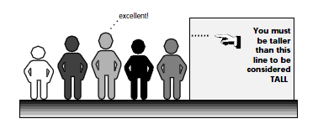
Fuzzy Logic
the set of tall people

Slide 50
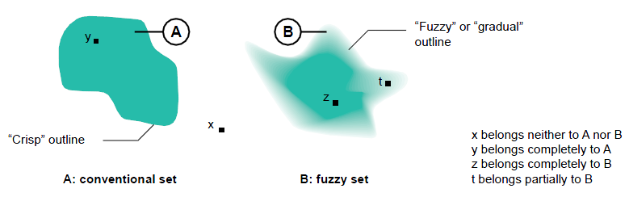
Classical Sets and Fuzzy Sets
X (Universe of discourse)
A classical set is defined by crisp boundaries
A fuzzy set is prescribed by vague or ambiguous properties; hence its boundaries are ambiguously specified

Slide 51
Fuzzy Sets
The boundaries of the fuzzy sets are vague and ambiguous. Hence, membership of an element from the universe in this set is measured by a function (membership function) that attempts to describe vagueness and ambiguity

Slide 52
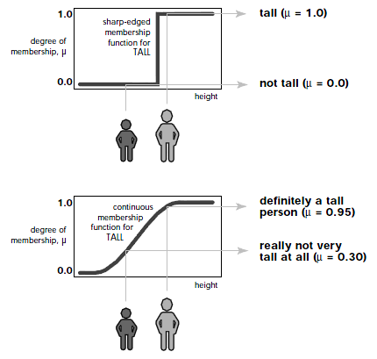
Fuzzy Logic

Slide 53
Fuzzy Logic
Elements of a fuzzy set are mapped to a universe of membership values.
fuzzy sets are denoted by a set symbol with a tilde
Ã would be the fuzzy set A or Fuzzy proposition
T(Ã) – Truth value associated with Ã (0-1)
Membership Function:
This function maps elements of a fuzzy set Ã to a real numbered value on the interval 0 to 1.
If an element in the universe, say x, is a member of fuzzy set Ã then this mapping is given by

Slide 54
Example
Ã : Ram is honest
T(Ã) = 0.8 if Ã is partly true
T(Ã) = 1 if Ã is absolutely true
T(Ã) =
Where 0 ≤ ≤ 1

Slide 55
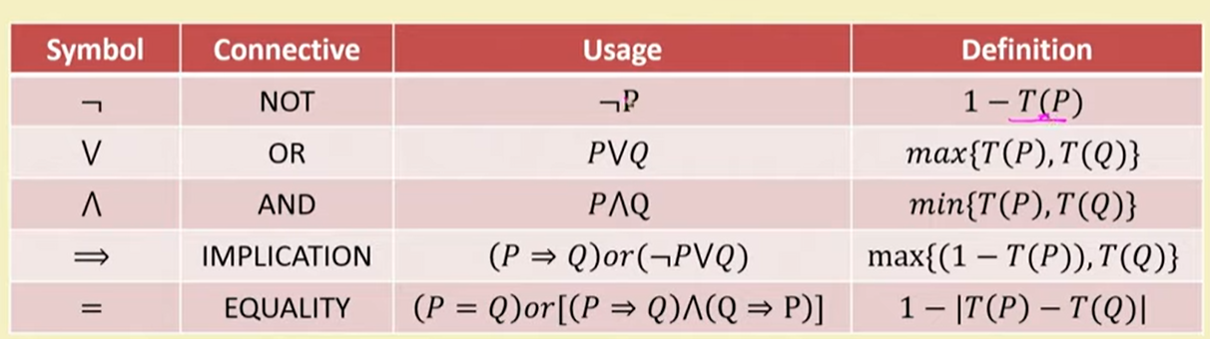
Fuzzy Connectives

Slide 56
Example
Ã : Mary is efficient, T(Ã) = 0.8
: Ram is efficient, T( ) = 0.65
Mary is not efficient
Mary is efficient and so is Ram
Either Mary or Ram is efficient
If Mary is efficient then so is Ram

Slide 57
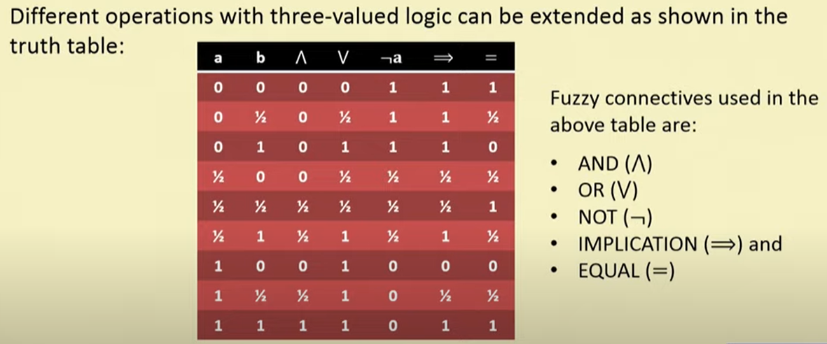

Slide 58
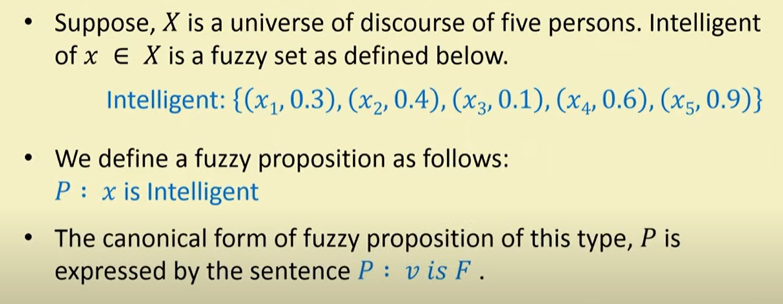
Canonical Representation of Fuzzy Set

Slide 59
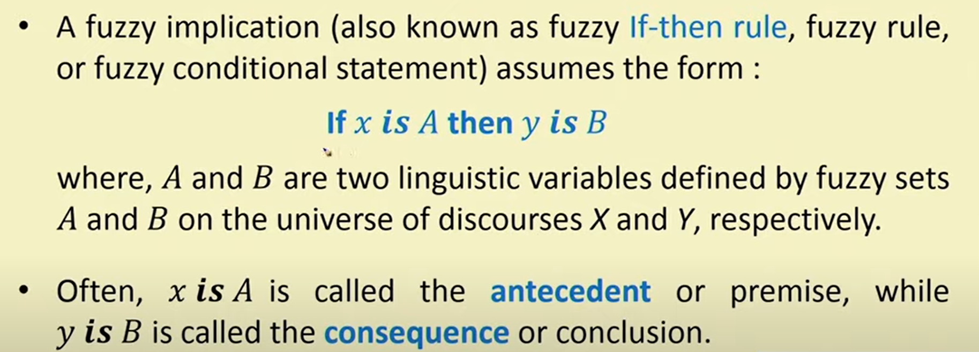
Fuzzy Rules and Implications

Slide 60
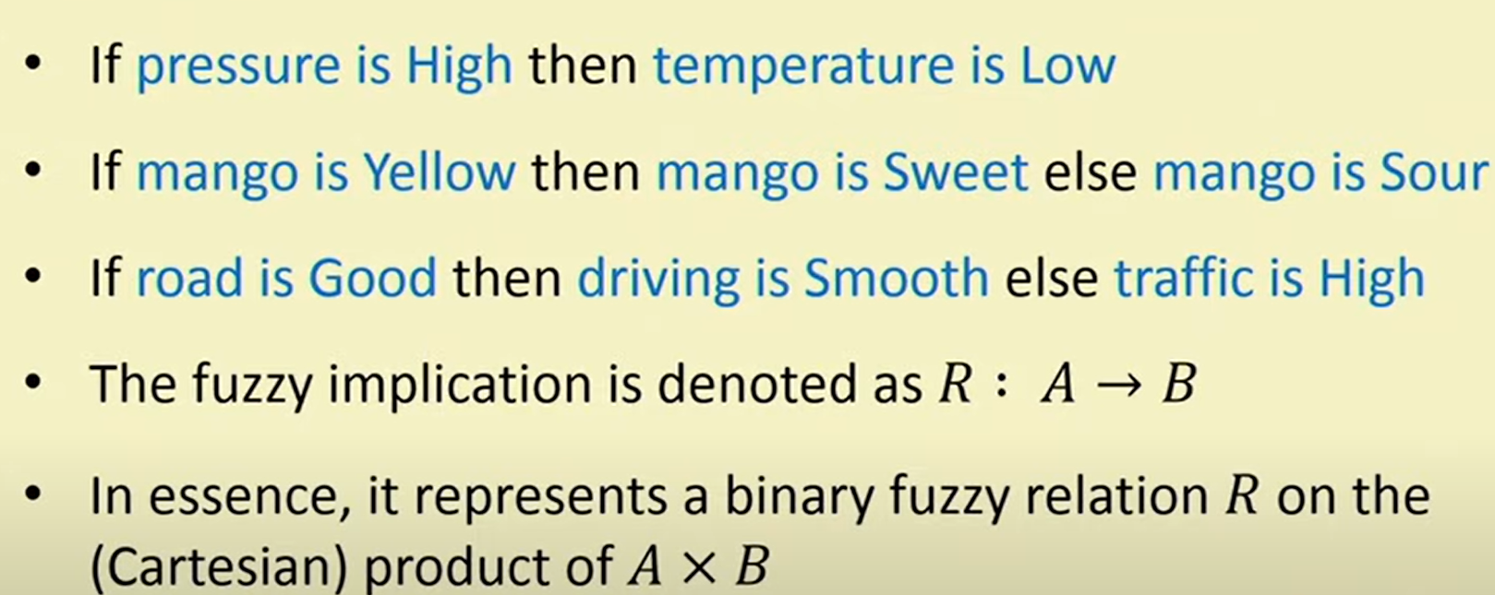
Fuzzy Rules and Implications

Slide 61
Example
Let X = {a, b, c, d} Y = {1, 2, 3, 4}
and
Ã : {(a,0) (b,0.8) (c,0.6) (d,1)}
: {(1,0.2) (2,1) (3,0.8) (4,0)}
: {(1,0) (2,0.4) (3,1) (4,0.8)}
Determine the implication relations:
IF x is Ã THEN y is
IF x is Ã THEN y is ELSE y is

Slide 62
Assignment
Let X = {20,30,40} Y = {20,50,70,90}
and
Ã : {(20,0.1) (30,0.5) (40,0.9)}
: {(20,0.2) (50,0.6) (70,0.7) (90,1)}
Determine the implication relations:
IF x is Ã THEN y is

Slide 63
Fuzzy Quantifiers
Absolute Quantifier : defined over
Relative Quantifier : defined over [0-1]
Example:
Sr. No. | Absolute | Relative
1 | round about 250 | almost
2 | much greater than 6 | about

Slide 64
Absolute Quantifier
For example, the proposition
p : "There are about 10 students in a given class whose fluency in English is high“
can be replaced with the proposition
p’ : "There are about 10 high-fluency English-speaking students in a given class."
Here, E is the fuzzy set of "high-fluency English-speaking students in a given class."

Slide 65
Relative Quantifier
These are quantifiers such as "almost all," "about half," "most," and so on. They are represented by fuzzy numbers on the unit interval [0, 1].

Slide 66
Fuzzy Inference
Two inferring procedures (Rules)
Generalized Modus Ponens (GMP)
Generalized Modus Tollens (GMT)

Slide 67
Generalized Modus Ponens (GMP)
IF x is Ã THEN y is
x is Ã’
-----------------------
y is ’
Everything above the line is analytically known
Everything below the line is analytically unknown
’ can be represented as ’ = Ã’ ◦ R̃(x, y)
In terms membership function,

Slide 68
Generalized Modus Tollens (GMT)
IF x is Ã THEN y is
y is ’
-----------------------
x is Ã’
Ã’ can be represented as Ã’ = ’ ◦ R̃(x, y)
In terms membership function,

Slide 69
There are many composition functions as follows:
Max-Min
Max-Product
Min-Max
Max-Max
Min-Min
From all these we are using Max-Min Composition relation.

Slide 70
Example
Apply the fuzzy Modus Ponens to deduce Rotation is quite slow given
If the temperature is high then the rotation is slow
The temperature is very high
Solution:
Let (High), (Very High), (Slow), (Quite slow) indicate the associated fuzz sets
For X= {30, 40, 50, 60, 70, 80, 90, 100}, the set of temperatures &
Y = {10, 20, 30, 40, 50, 60}, the set of rotations per minute

Slide 71
Example
= {(70, 1) (80, 1) (90, 0.3)}
= {(90, 0.9) (100, 1)}
= {(10, 1) (20, 0.8)}
= {(30, 0.8) (40, 1) (50, 0.6)}
To derive R̃(x, y) representing the implication relation, we need to compute
R̃(x, y) = max( )

Slide 72
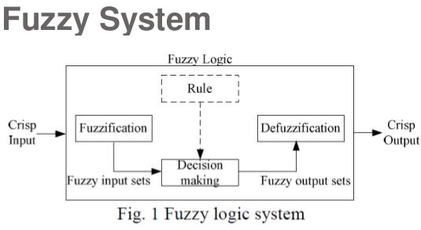
Defuzzification

Slide 73
Defuzzification methods
Centroid Method
Centre of sums method
Mean of Maxima Method

Slide 74
Centroid Method
It obtains the center of area (x*) occupied by the fuzzy set
Also known as Centre of Gravity or Centre of Area method
For continues membership function
For discrete membership function

Slide 75
Centre of Sums(COS) Method
In Centroid method overlapping area is counted once but in COS overlapping area is counted twice
Where, n – No. of Fuzzy Sets
N – No. of Fuzzy Variables

Slide 76
Mean of Maxima (MOM) Method
If more than one element having the maximum value, then mean of maxima is taken.
For Discrete :
M = {x_{i}|µ(x_{i}) is the height of fuzzy set}
|M| - Cardinality of set M.
For Continuous:
M = {x Є [-c,c] |µ(x) is height of fuzzy set}
h(Ã) = largest membership grade obtained by any element in that set

Slide 77
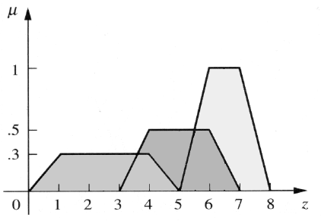
EXAMPLE
Aggregated fuzzy set of Ã₁, Ã₂, Ã₃
3.6 5.5

Slide 78
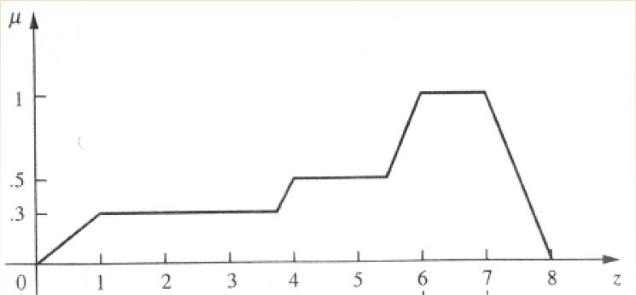
1. Centroid Method
7
4
8
5
6
2
9
1
3

Slide 79
Sr. No. | Area | Centroid (x) | A*x
1 | ½ * 0.3 *1 =0.15 | (0 + 1 + 1) / 3 = 0.67
2 | 2.6 * 0.3 = 0.78 | (3.6 + 1) / 2 = 2.3
3 | 0.4 * 0.3 = 0.12 | (4 + 3.6) / 2 = 3.8
4
5
6
7
8
9
Total
X* = 18.3986/2.715 = 4.9525

Slide 80
2. Centre of sums Method

Slide 81
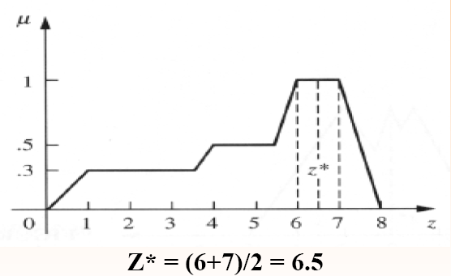
3. Mean of Maxima Method

Slide 82
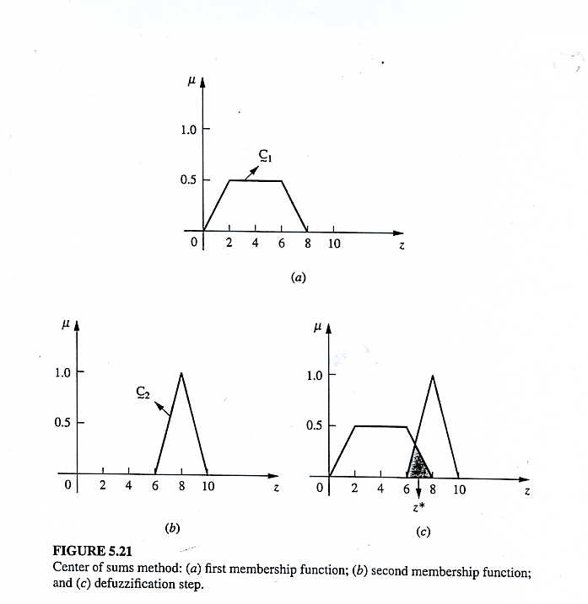
Assignment

Slide 83
Fuzzy Rule Based System
Fuzzy rule base : A collection of rules referring to a particular system.
The fuzzy rule is represented by a sequence of the form IF THEN.
The IF part is mainly used to capture knowledge by using the conditions.
THEN part can be utilized to give the conclusion or output.

Slide 84
Fuzzy Rule Based System: Example
IF (a set of conditions) are satisfied THEN (a set of consequents) can be inferred.
Example
If there is heavy rain and strong winds,
then there must be severe flood warning.

Slide 85
Fuzzy Rule Based System
IF the conclusion C is the conjunction of all the individual consequence Ci of each rule then,
Where,
IF the conclusion C is the disjunction of all the individual consequence Ci of each rule then,
Where,

Slide 86
Fuzzy logic Algorithm
Define the variables and terms (initialization)
Construct the membership functions (initialization)
Construct the rule base (initialization)
Convert crisp input data to fuzzy values using the membership functions (fuzzification)
Evaluate the rules in the rule base (inference)
Combine the results of each rule (inference)
Convert the output data to non-fuzzy values (defuzzification)

Slide 87
Fuzzy Logic Application
Fuzzy Cruise Controller
It is used to maintain a vehicle at a desired speed
Speed difference
Fuzzy Cruise Controller
Throttle control
Acceleration

Slide 88
Sample Cruise Control Rule Base
Rule 1 | If (speed difference is NL ) and (acceleration is ZE) then (throttle control is PL)
Rule 2 | If (speed difference is ZE ) and (acceleration is NL) then (throttle control is PL)
Rule 3 | If (speed difference is NM ) and (acceleration is ZE) then (throttle control is PM)
Rule 4 | If (speed difference is NS ) and (acceleration is PS) then (throttle control is PS)
Rule 5 | If (speed difference is PS ) and (acceleration is NS) then (throttle control is NS)
Rule 6 | If (speed difference is PL ) and (acceleration is ZE) then (throttle control is NL)
Rule 7 | If (speed difference is ZE ) and (acceleration is NS) then (throttle control is PS)
Rule 8 | If (speed difference is ZE ) and (acceleration is NM) then (throttle control is PM)
KEY: NL –Negative Large PM – Positive Medium
ZE – Zero NS – Negative Small
PL – Positive Large PS – Positive Small
NM – Negative Medium

Slide 89
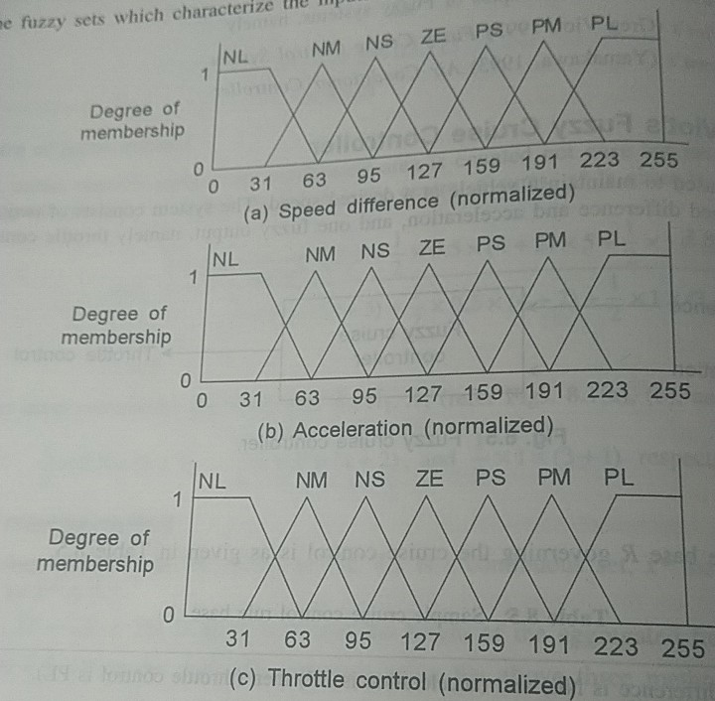
Fuzzy Sets

Slide 90
Fuzzification of inputs
For the fuzzification of inputs i.e. membership of antecedents, the formula is-
Delta 1= x-point 1
Delta 2= point2-x
If (Delta1<=0) or (Delta2<=0)
Then degree of membership=0
Else degree of membership=
min ((Delta1*slope1), (Delta2*slope2), Max)

Slide 91
Example
Let the measured normalized speed difference be 100 and the normalized acceleration be 70, then the fuzzified inputs after computation of fuzzy membership values are as shown.

Slide 92
Speed difference
Acceleration
Inputs
100
70
0
NL
0
NL
0
NM
0.7813
NM
0.8436
NS
0.2188
NS
Membership function values
0.1563
ZE
0
ZE
0
PS
0
PS
0
PM
0
PM
0
PL
0
PL

Slide 93
Rule Strength Computation
Obtained by computing the minimum of the membership functions of the antecedents.
Example:
Rule 1: min(0,0)=0
Rule 2: min(0.1563,0)=0

Slide 94
Fuzzy Output
It is the “fuzzy OR” of all the fuzzy outputs of the rules with non zero rule strengths.
If more than one rule qualifying for the same fuzzy output, the stronger among them is chosen.
Example
In given rule base R, the competing fuzzy outputs are those of rules 7 & 8 with strength 0.1563
Hence, defuzzification is required.

Slide 95
Defuzzification
For defuzzification, any of the three method is applied.
Centre of gravity is mostly used.
Example:
Apply defuzzification for the two competing outputs of rules 7 & 8 with strength of 0.1563 each.

Slide 96
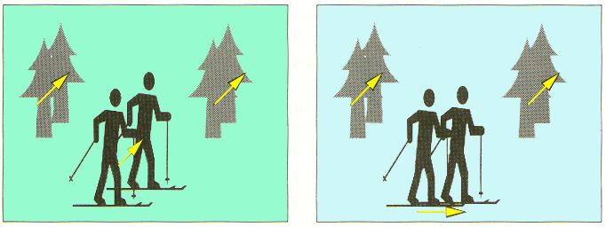
Fuzzy Logic Applications
Image Stabilization via Fuzzy Logic
“If all motion vectors are almost parallel and their time differential is small, then
the hand jittering is detected and the direction of the hand movement
is in the direction of the moving vectors”.

Slide 97
Fuzzy Logic Applications
Aerospace
  Altitude control of spacecraft, satellite altitude control, flow and mixture regulation in aircraft deiceing vehicles.
Automotive
  Trainable fuzzy systems for idle speed control, shift scheduling method for automatic transmission, intelligent highway systems, traffic control, improving efficiency of automatic transmissions

Slide 98
Fuzzy Logic Applications (Cont.)
Business
  Decision-making support systems, personnel evaluation in a large company
Chemical Industry
  Control of pH, drying, chemical distillation processes, polymer extrusion production, a coke oven gas cooling plant

Slide 99
Fuzzy Logic Applications (Cont.)
Defense
  Underwater target recognition, automatic target recognition of thermal infrared images, naval decision support aids, control of a hypervelocity interceptor, fuzzy set modeling of NATO decision making.
Electronics
  Control of automatic exposure in video cameras, humidity in a clean room, air conditioning systems, washing machine timing, microwave ovens, vacuum cleaners.

Slide 100
Fuzzy Logic Applications (Cont.)
Financial
  Banknote transfer control, fund management, stock market predictions.
Industrial
  Cement kiln controls (dating back to 1982), heat exchanger control, activated sludge wastewater treatment process control, water purification plant control, quantitative pattern analysis for industrial quality assurance, control of constraint satisfaction problems in structural design, control of water purification plants

Slide 101
Fuzzy Logic Applications (Cont.)
Manufacturing
  Optimization of cheese production.
Marine
  Autopilot for ships, optimal route selection, control of autonomous underwater vehicles, ship steering.
Medical
  Medical diagnostic support system, control of arterial pressure during anesthesia, multivariable control of anesthesia, modeling of neuropathological findings in Alzheimer's patients, radiology diagnoses, fuzzy inference diagnosis of diabetes and prostate cancer.

Slide 102
Fuzzy Logic Applications (Cont.)
Mining and Metal Processing
  Sinter plant control, decision making in metal forming.
Robotics
  Fuzzy control for flexible-link manipulators, robot arm control.
Securities
  Decision systems for securities trading.

Slide 103
Fuzzy Logic Applications (Cont.)
Signal Processing and Telecommunications
  Adaptive filter for nonlinear channel equalization control of broadband noise
Transportation
  Automatic underground train operation, train schedule control, railway acceleration, braking, and stopping

Slide 104
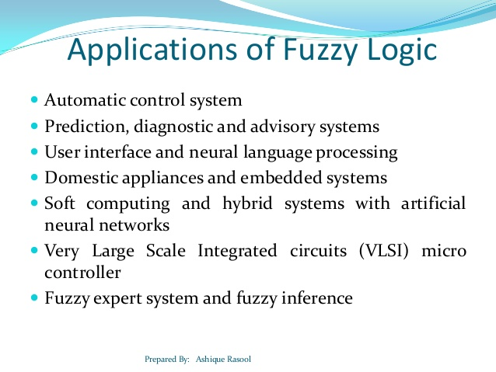

Slide 105
